Slide 1

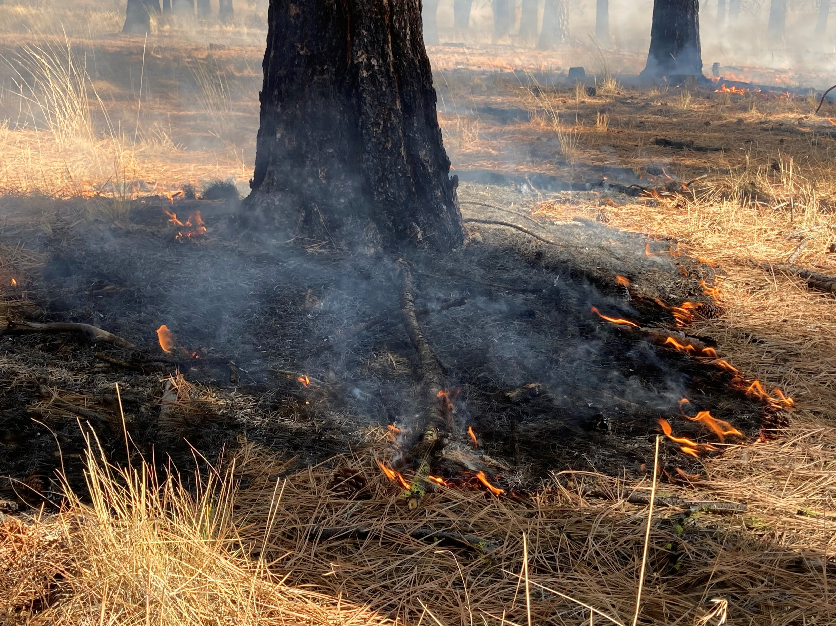
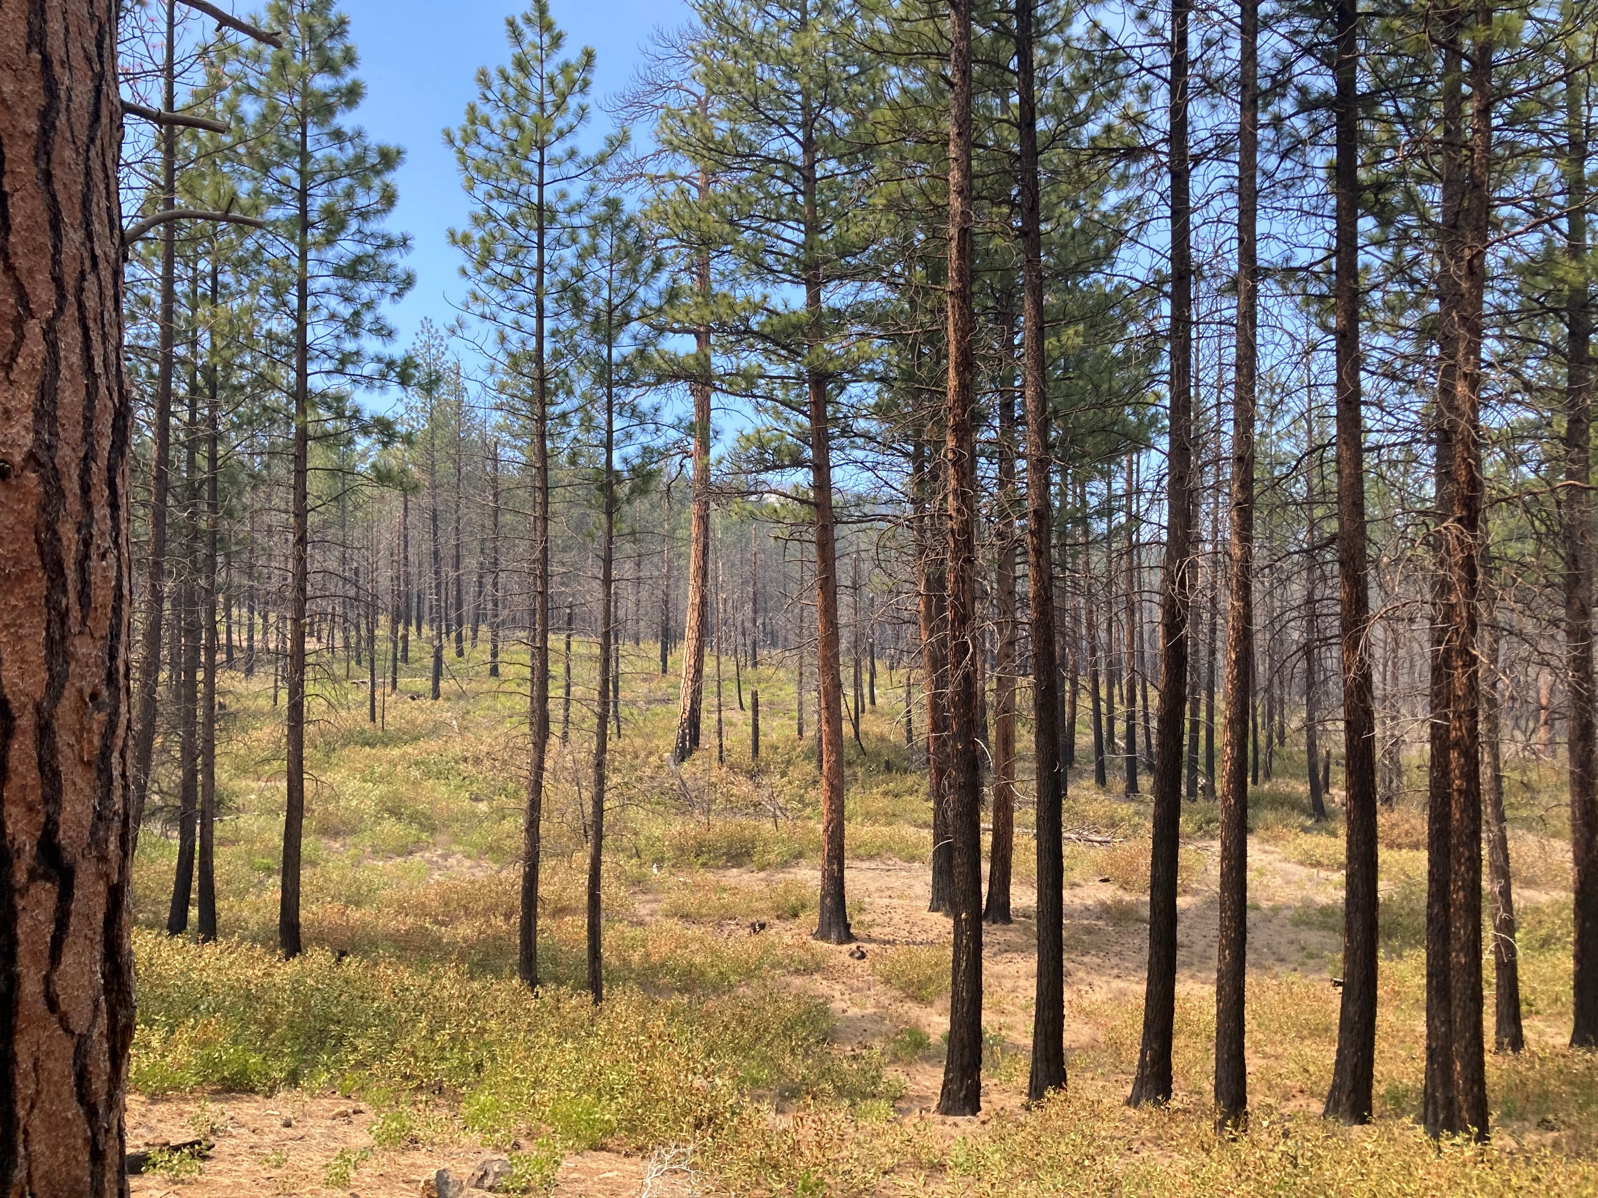
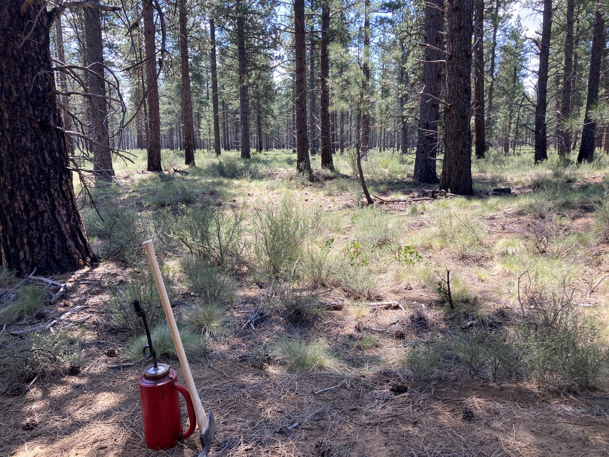
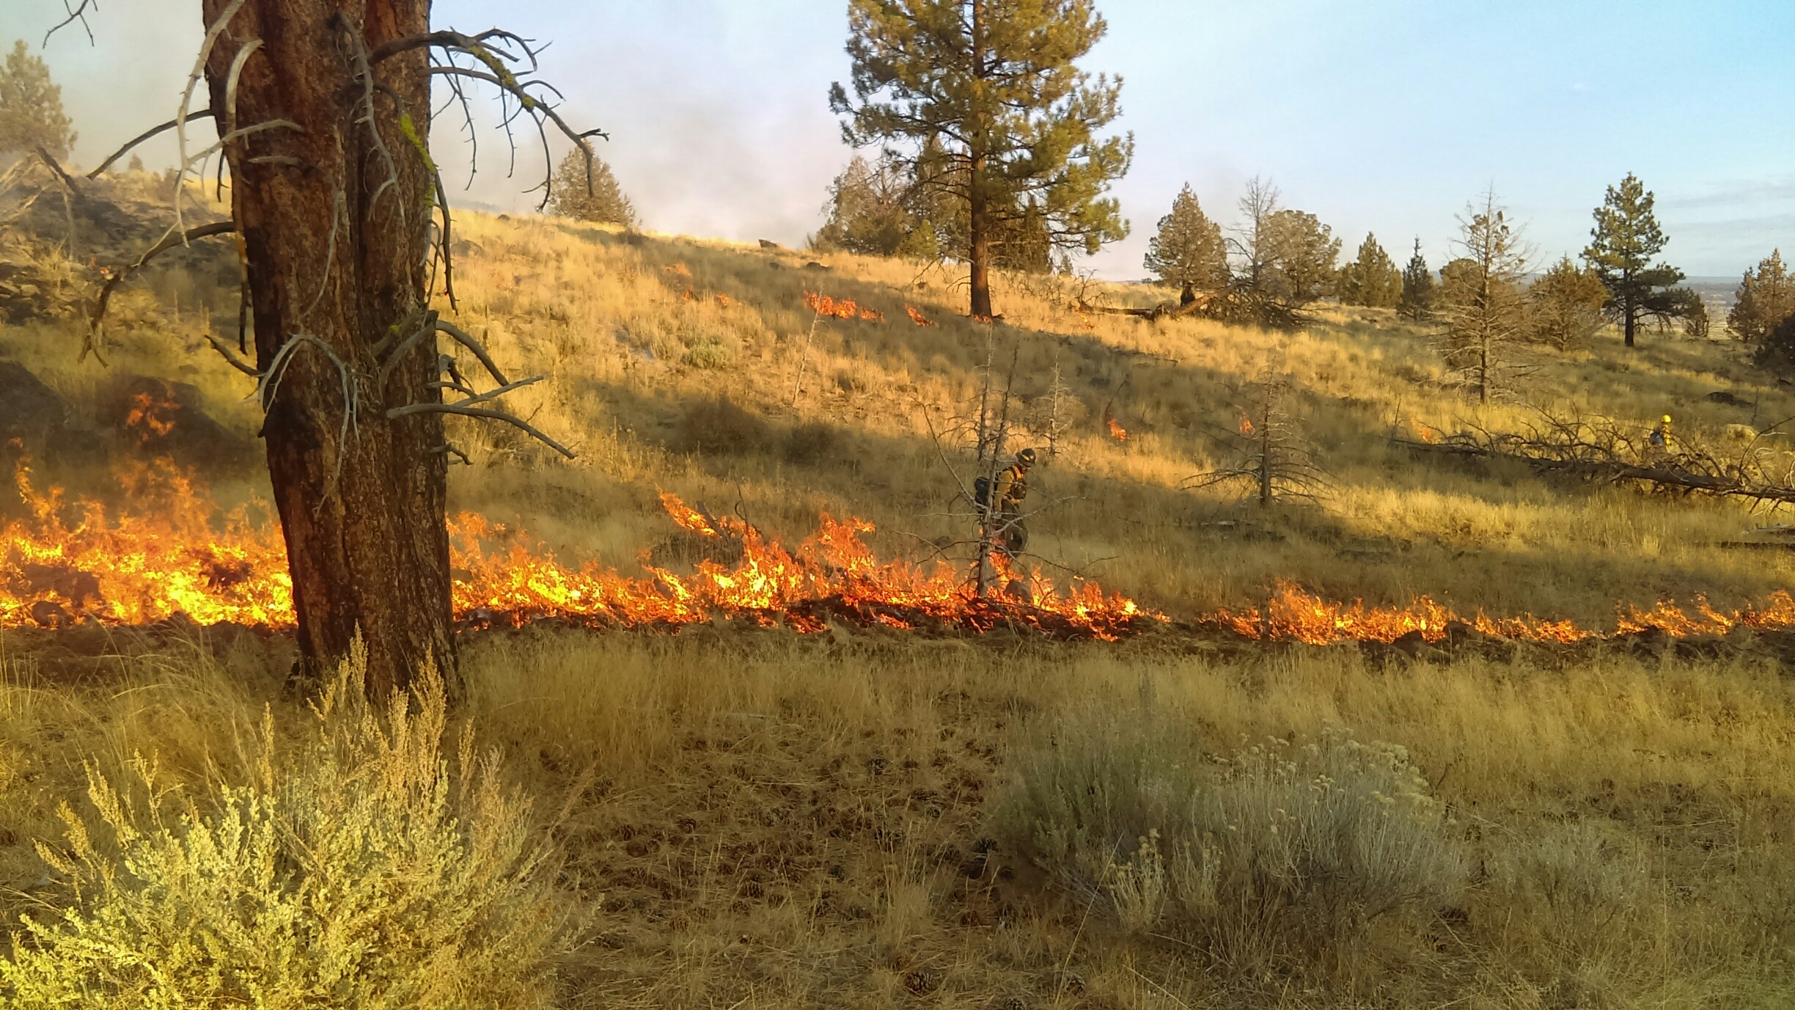
Building a prescribed fire database for the western United States
Kori Blankenship & Teresa Chapman
The Nature Conservancy
Association for Fire Ecology Congress, December 2023
kblankenship@tnc.org ~ tchapman@tnc.org

Slide 2
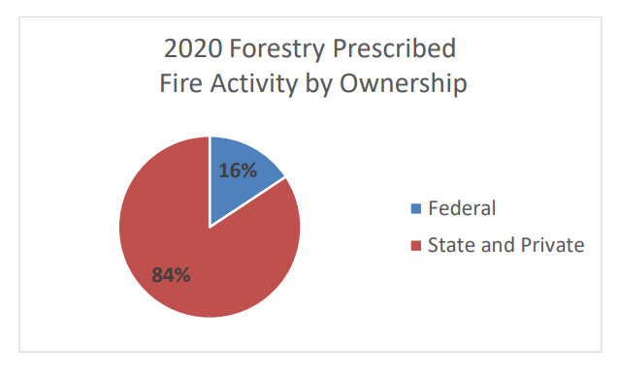
Background
Do not know location of private burning in the West.
Data from the National Prescribed Fire Use Survey Report
Figure: 2021 National Prescribed Fire Use Survey Report, Coalition of Prescribed Fire Councils and the National Association of State Foresters
Notes:
Problem:
Interested in fuel tx effectiveness
No reporting system for all burns
Difficult to detect rx fire remotely, private burns generally not collect in public repository
1.5 m acres fed burning
7.9 acres state and private
2021-National-Rx-Fire-Use-Report_FINAL.pdf (prescribedfire.net)
Prepared by the Coalition of Prescribed Fire Councils and the National Association of State Foresters based on a survey of prescribed fire use data collected in 2020

Slide 3
Objective
Collect public burn records from 11 western states
 | Burn Type¹ | Complete² | Polygon³ | Years of Collection
 |  |  |  | pre-2010 | 2010 | 2011 | 2012 | 2013 | 2014 | 2015 | 2016 | 2017 | 2018 | 2019 | 2020 | 2021 | 2022
AZ |  | X
CA | X | X | X
CO | X | X | X
ID | X
MT | X | X
ND
NM | X | X
NV | X | X
OR | X | X
SD
UT | X | X
WA | X |  | X
WY | X | X
¹Burn type indicates whether the permit distinguishes broadcast, pile, and other types of burning.
²Complete indicates state where burn completion is tracked. If it is not tracked, we only know what was permitted.
³Polygon indicates states with additional state-level polygon data about prescribed burns.
Notes:
To do: gray or orange color scheme, clean,
To study fuel tx effectiveness, gathered
Public records requests for state permits to get more complete picture
State permit data are, to our knowledge, an untapped resource for tracking prescribed burns. These data will be especially useful for tracking burning on private lands, which are largely left out of other data collection efforts.
~275k points
ND IS WRONG HERE
Make a horizontal bar plot w/ # of records and give the n as shown in screen cap above
Map: burn type reported, ag burns, Indian lands burns, permitted, complete, request

Slide 4
Methods
Cleaning
Standardizing
Identifying unique burns
state, year, location, burn type, tracking number, burn name
Database attributes
Date
Latitude
Longitude
Acres permitted
Acres completed
Pile volume
Burn name
Burn type
Entity requesting
Notes:
1. cleaning: removed ag, barrel burning, fixed lat/lons
2. Standardizing – classified as burn/pile, limited to overlapping years

Slide 5
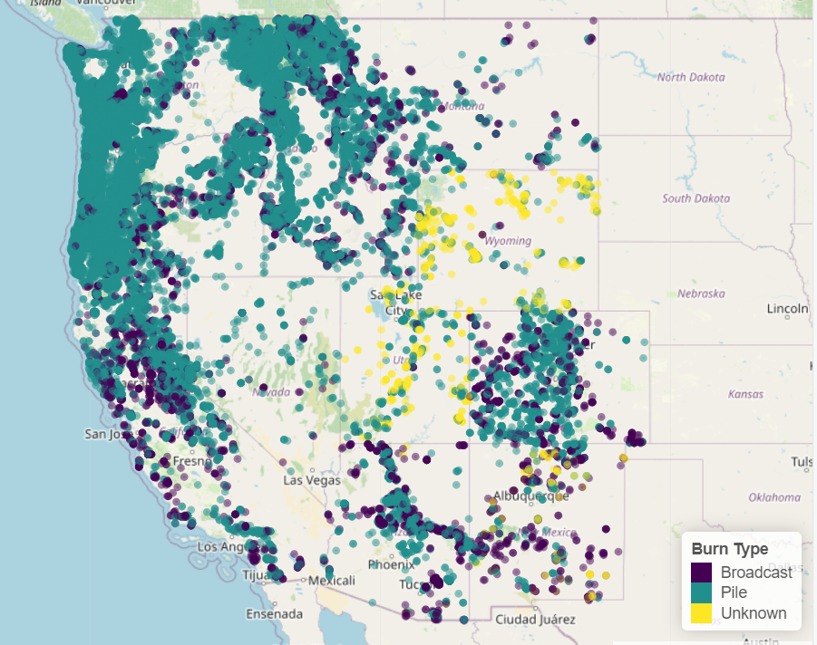
Results
Planned and completed burns 2017-2022
# Broadcast
# Piles
# Unknown
_________________
# Total
Notes:
56,610 burns
To do: Put link to interactive map; and qr code

Slide 6
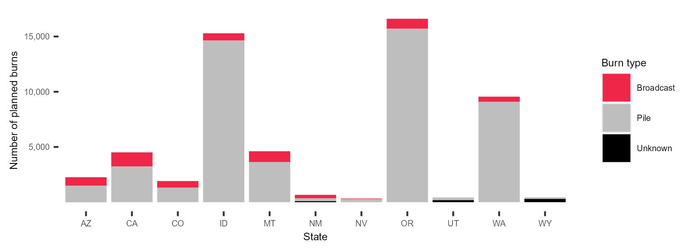
Results
Westwide - X times more pile than broadcast burned planned or completed.
Number of planned burns 2017-2022 (n = 11)
Notes:
Add all west
Make broadcast orangy color that matches the theme

Slide 7
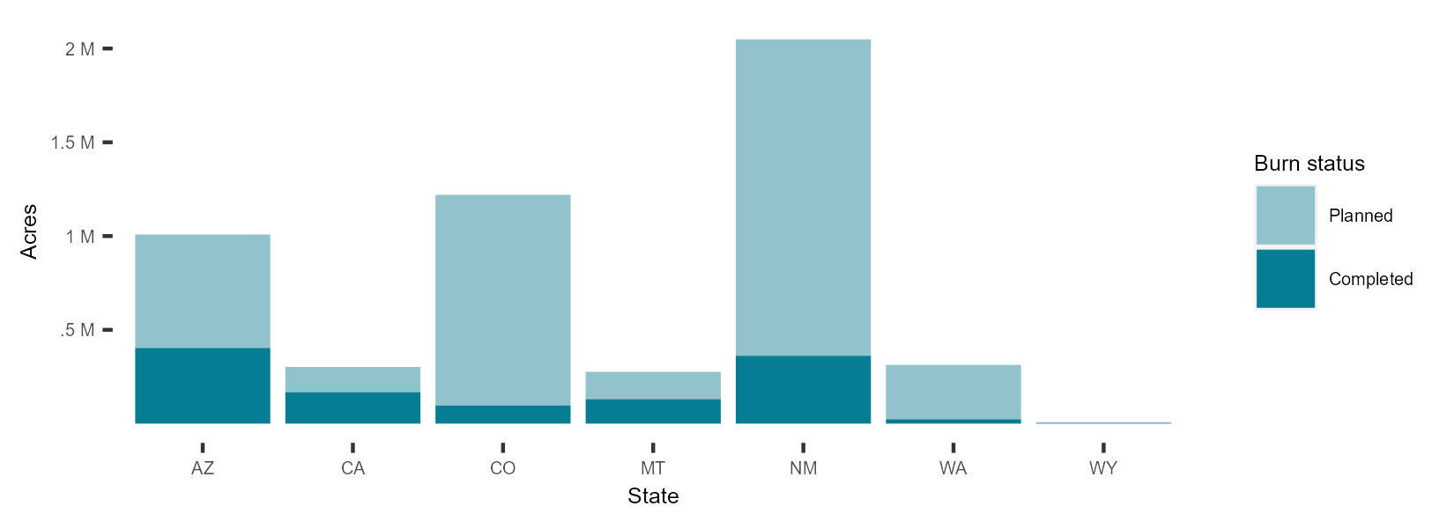
Results
Westwide - X times more broadcast burns are planned than completed.
Acres of completed broadcast burns 2017-2022 (n = 7)
Notes:
Colors: dark orange is complete; other orange for planned; or grey and black
Fix font size
OVERAL BY STATE, NOT YEAR
ACRES ON THE GRAPH (AT TOP OF EACH STATE GIVE A PERCENT); ADD AS TEXT THE % COMPLETE FOR EACH STATE
-add west
*estimated******
Map icon in bottom showing states included
Planned acres: permitted acres, max requested acres
* Change y lable to “Area burned (acres)

Slide 8
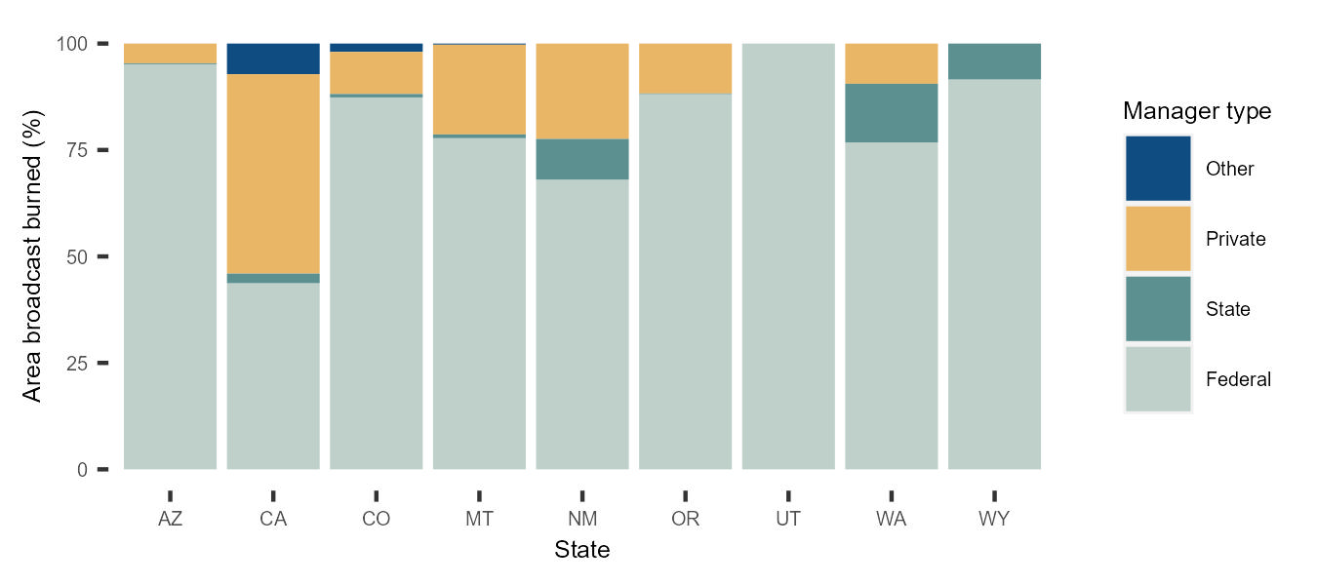
Results
Westwide - Broadcast burns on private lands account for x% of acres burned.
Percent area broadcast burned by land manager 2017-2022 (n = 9)
Notes:
Add West,
[put % in the legend or the box]

Slide 9
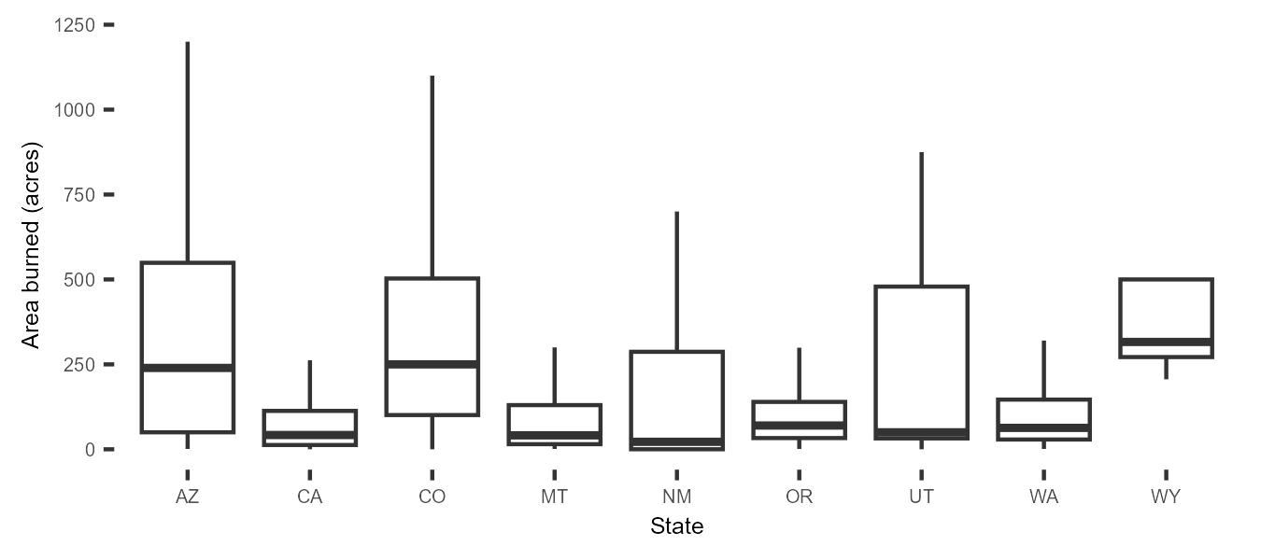
Results
Westwide -
Size of completed broadcast burns 2017-2022 (n = 9)
Notes:
*** add the west

Slide 10
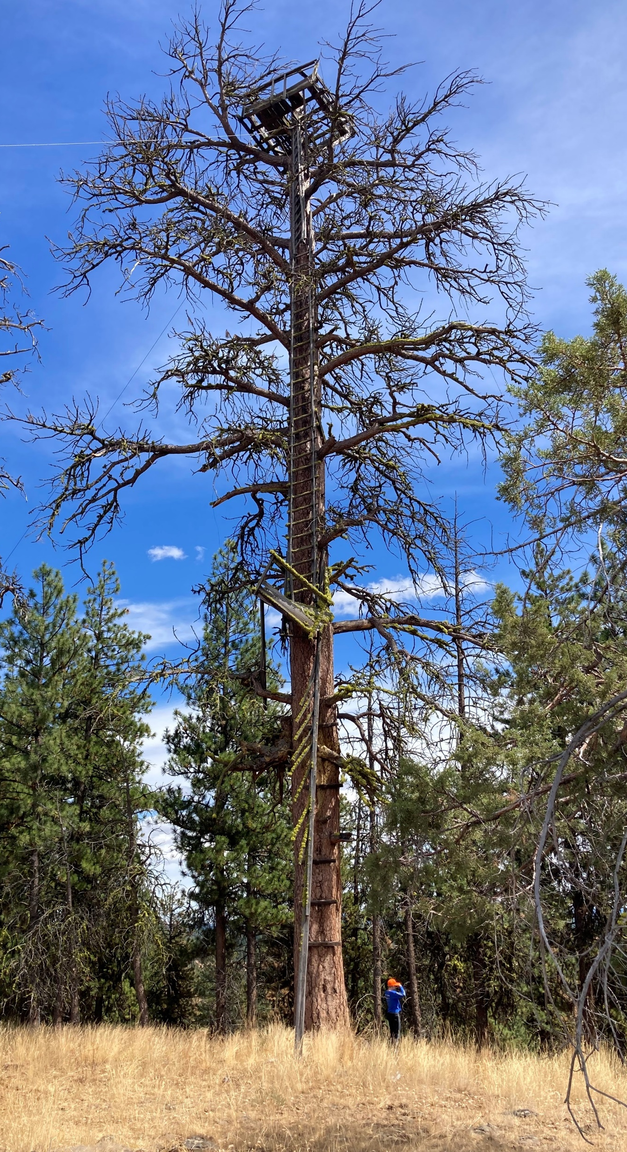
Summary
More pile than broadcast burn records.
More broadcast burns are planned than completed.
Majority of broadcast burns occur on federal lands in the West.
Broadcast burns remain relatively small in size.
Understanding of prescribed burning is limited due to lack of data consistencies and completeness.
Black Mountain lookout tree, OR.
Notes:
Time specific and for the west

Slide 11
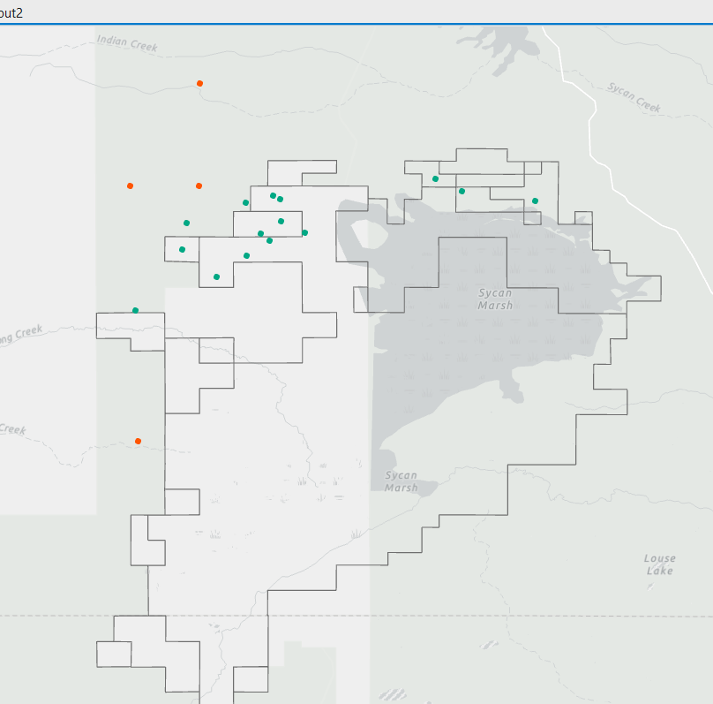
Next steps
Sycan Marsh Preserve completed burns
Notes:
TO DO: improve map, bigger points, picture from Sycan
Work on making the data more complete, add TNC points?
Validation: imagery, other data sources (NFPORS, FACTS)

Slide 12
Questions

